Slide 1

Crimes in Dublin Council
Shishir Ashoka Chandra Mouli - 24250416
A Spatial analysis of Crime Patterns and Infrastructure Influence using PostgreSQL and QGIS
Notes:
Hello everyone, my name is Shishir. In this project, I used PostgreSQL and QGIS to explore crime patterns across Dublin council’s administrative areas and examined the relationship between crime hotspots and nearby infrastructure.

Slide 2
Introduction
Objective
Analyse crime data across Dublin Council’s administrative regions and explore relationships between crime hotspots and nearby infrastructure.
Tools and methods:
PostgreSQL for spatial queries and data aggregation.
QGIS for visualization and analysis.
Key Questions
Which regions have the highest crime counts?
Are there spatial patterns in crime occurrences?
How does proximity to amenities (e.g., pubs, hospitals) relate to crime?
Notes:
This story begins with a fundamental question:
What do crime patterns in Dublin look like, and what role does infrastructure play in these patterns?
To answer this, I focused on three main questions:
Which regions experience the most crimes?
Are there spatial hotspots where crimes cluster?
What types of buildings or amenities are located near crime areas, and could they influence these patterns?
Using administrative boundaries, crime data, and building information, I conducted an end-to-end spatial analysis combining PostgreSQL queries and QGIS visualizations.

Slide 3
Data Overview
Crime Data
Dataset: Sourced from ACLED (Armed Conflict Location and Event Data)
Administrative Boundaries and Buildings
Dublin councils and subdivisions from Overpass Turbo (GeoJSON).
Preprocessing
All layers converted to SRID 4326 for consistency.
Buffer and spatial joins in PostgreSQL.
Views from PostgreSQL to visual data in QGIS
Notes:
The analysis leveraged three datasets:
Crime Data: Detailed crime records with geospatial coordinates.
Administrative Boundaries: Region-level divisions in Dublin.
Building Data: Locations of schools, hospitals, pubs, and other amenities sourced from OpenStreetMap.
After preprocessing, all data was standardized to the same coordinate reference system, EPSG 4326, to ensure accuracy in spatial joins and queries.

Slide 4
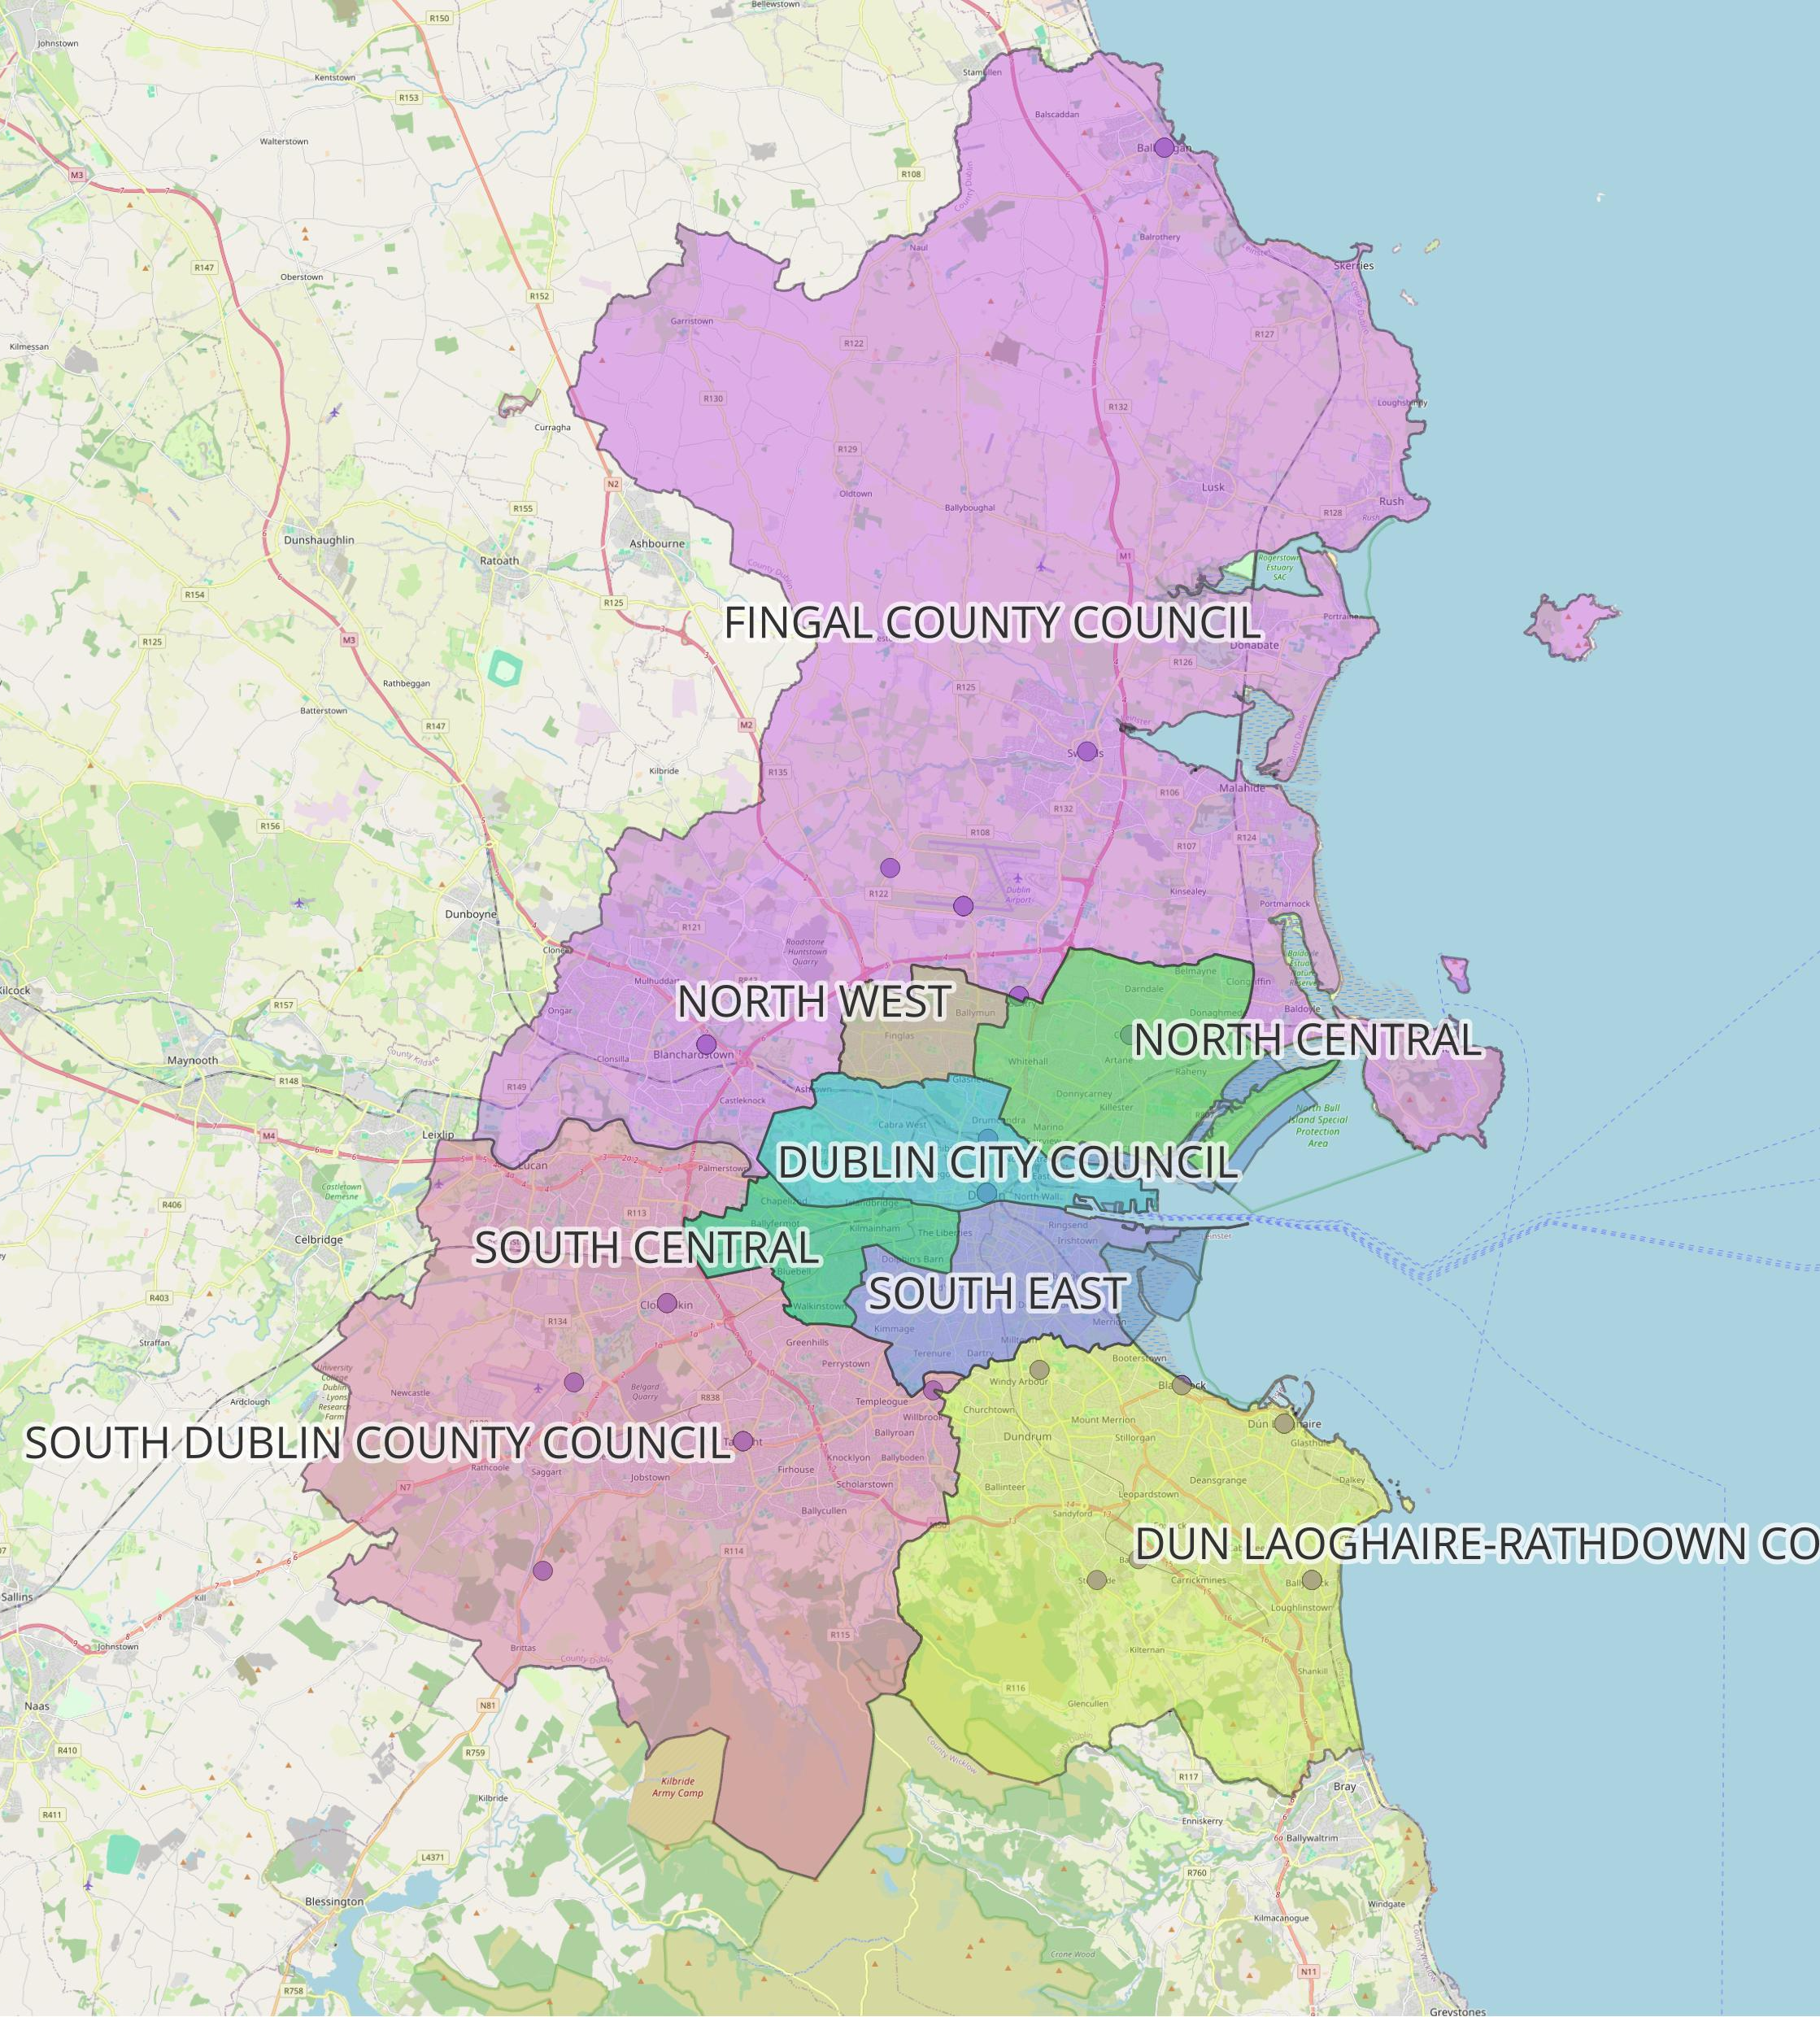
Administrative Boundaries
Map shows the administrative boundaries of Dublin Council (Dublin City Council, Fingal, South Dublin, Dun Laoghaire-Rathdown)
Provides the base layer for analysis.
Unified boundaries using GeoJSON merging.
Regions are key for aggregating crime statistics.
Notes:
To start, I mapped Dublin’s administrative boundaries. This includes regions within Dublin like North west, North central.. as well as Dublin Council areas like South Dublin and Fingal.
This step provided a foundation for showcasing crime statistics regionally, highlighting the spatial context for the rest of the analysis.

Slide 5
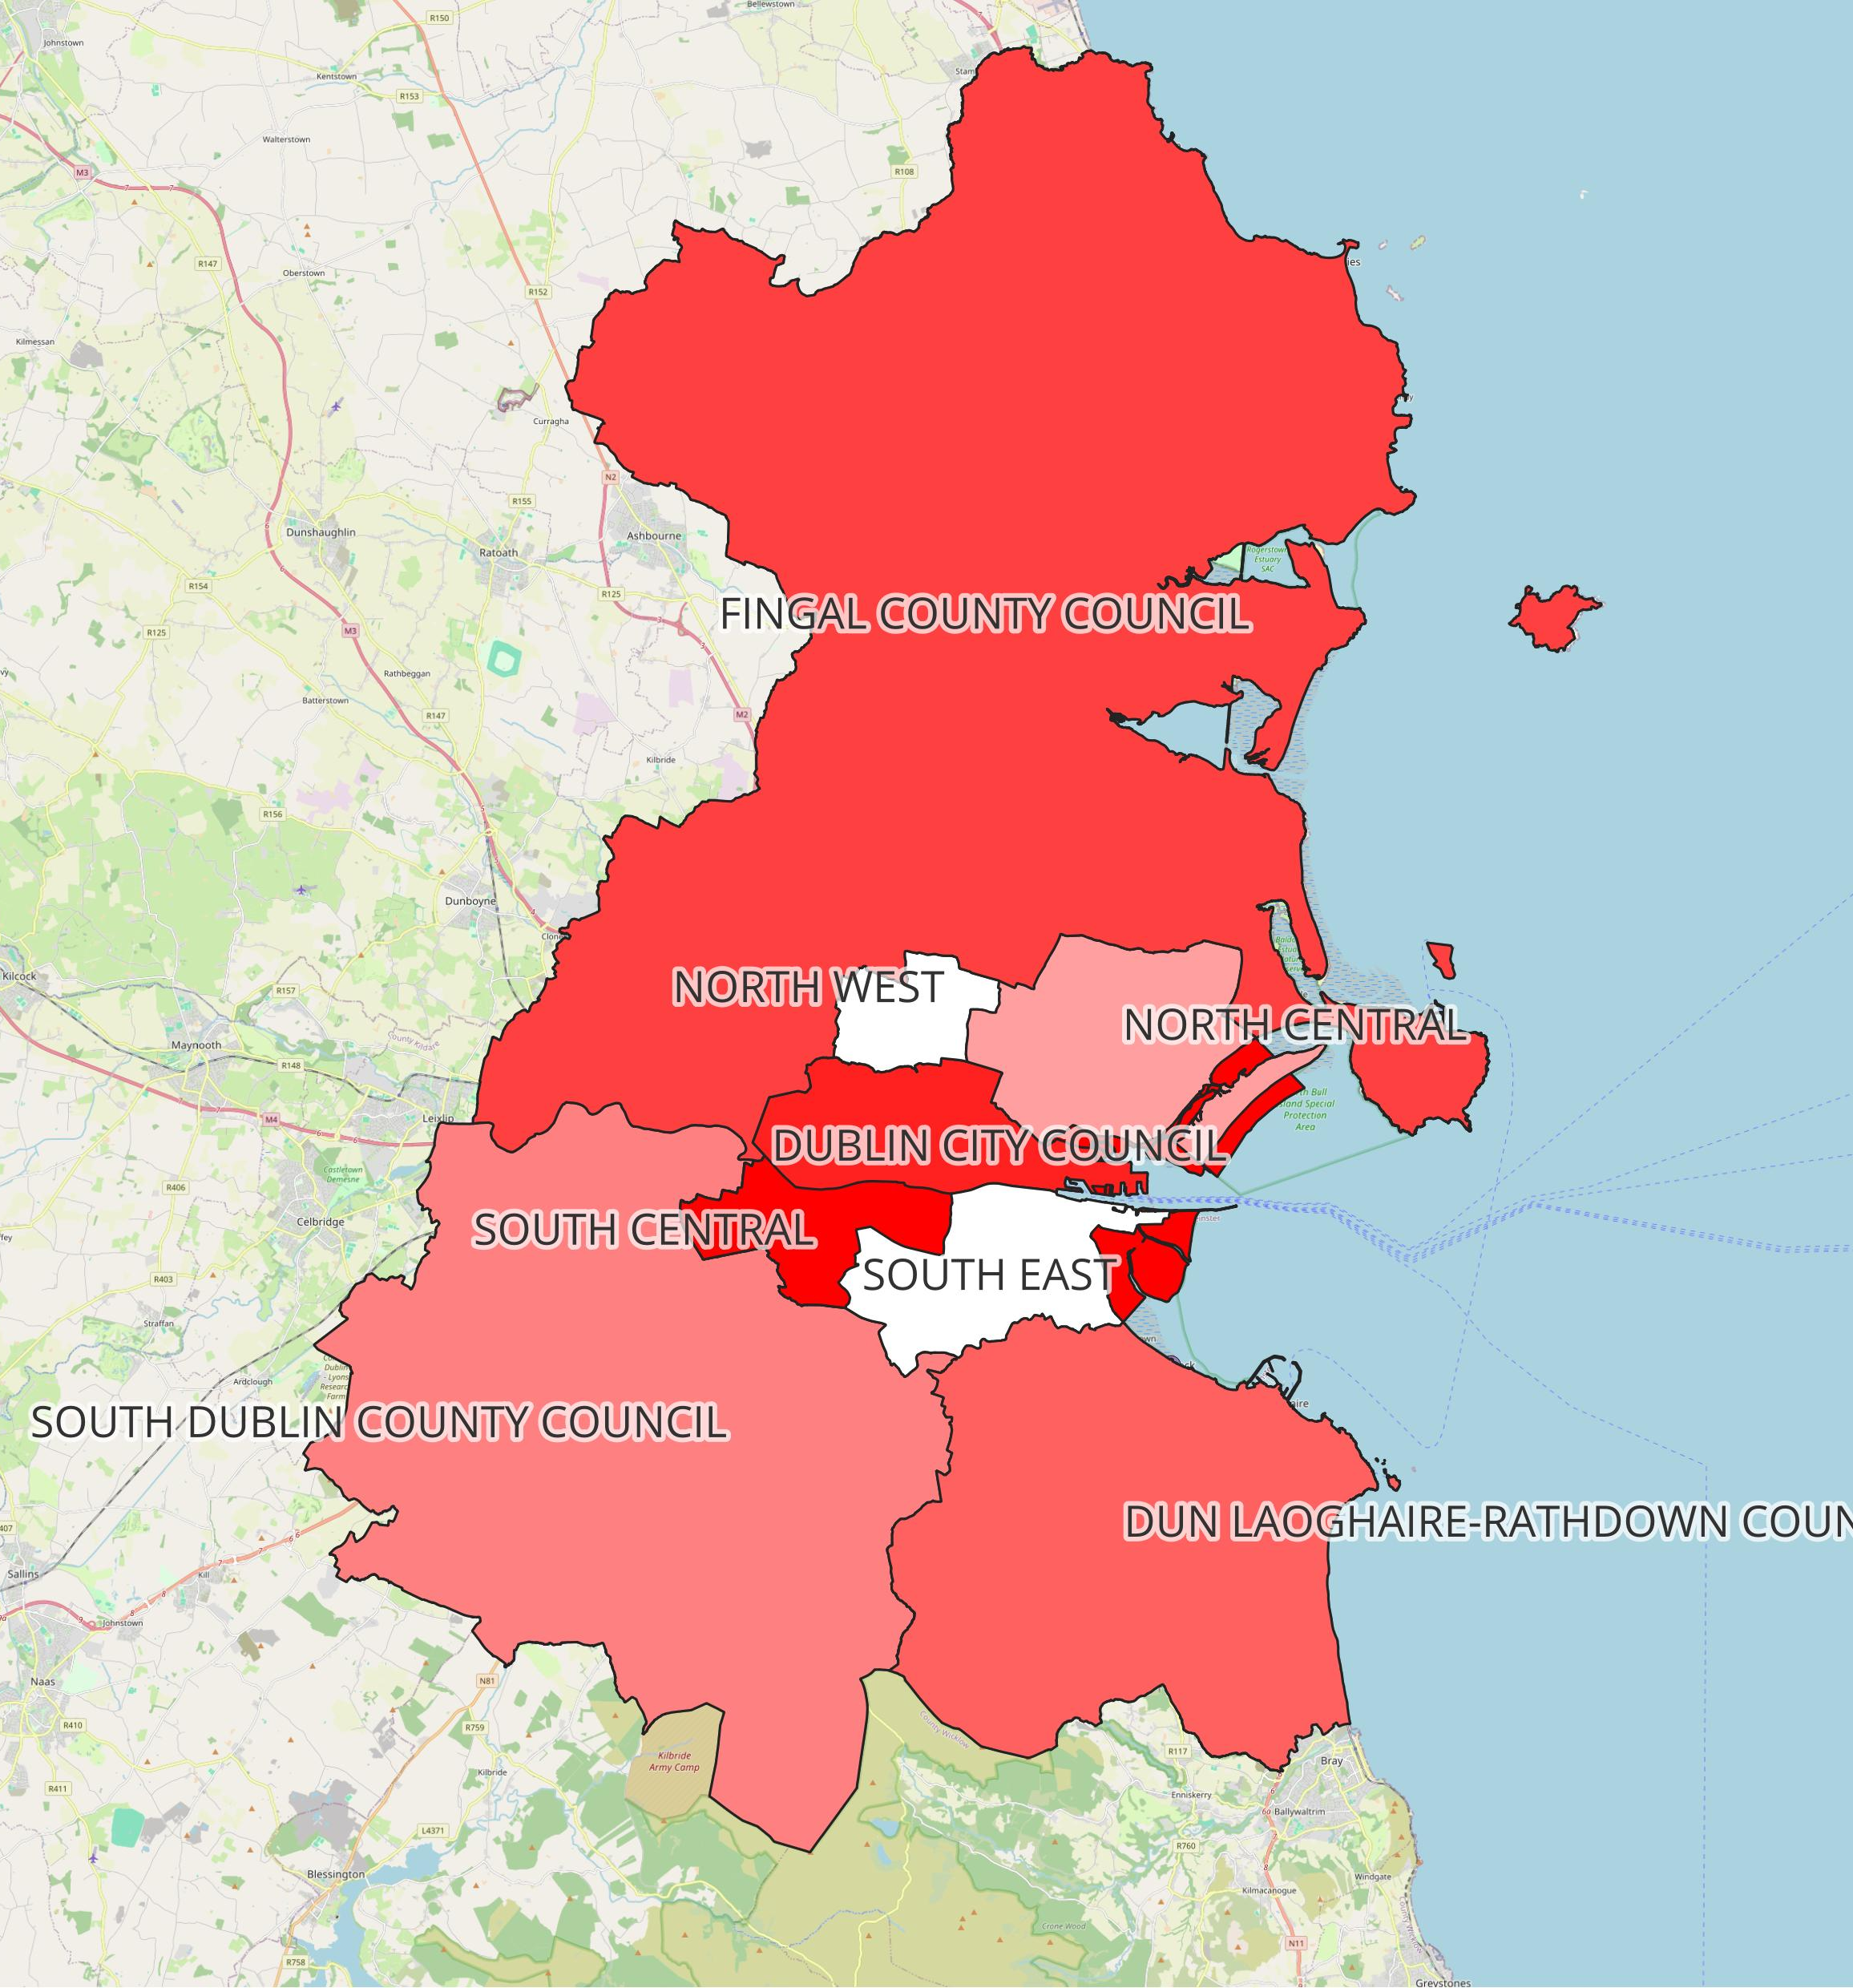
Crime Statistics by Region
Choropleth map of crime counts for each region.
High-level view of crime distribution:
Dublin City Council: 548 incidents.
Fingal: 20 incidents.
South Dublin: 10 incidents.
Dun Laoghaire-Rathdown: 15 incidents.
Insights:
Significant crime disparity between regions.
Central regions (Dublin City Council) need more attention.
Notes:
Next, I created a choropleth map to visualize crime distribution.
The results showed a stark contrast:
Dublin City Council reported 548 crimes, dominating the map.
In comparison, other regions like Fingal and South Dublin reported fewer than 20 crimes each.
This disparity stresses upon the concentration of crime in Dublin, which is likely linked to population density and urban activity.

Slide 6
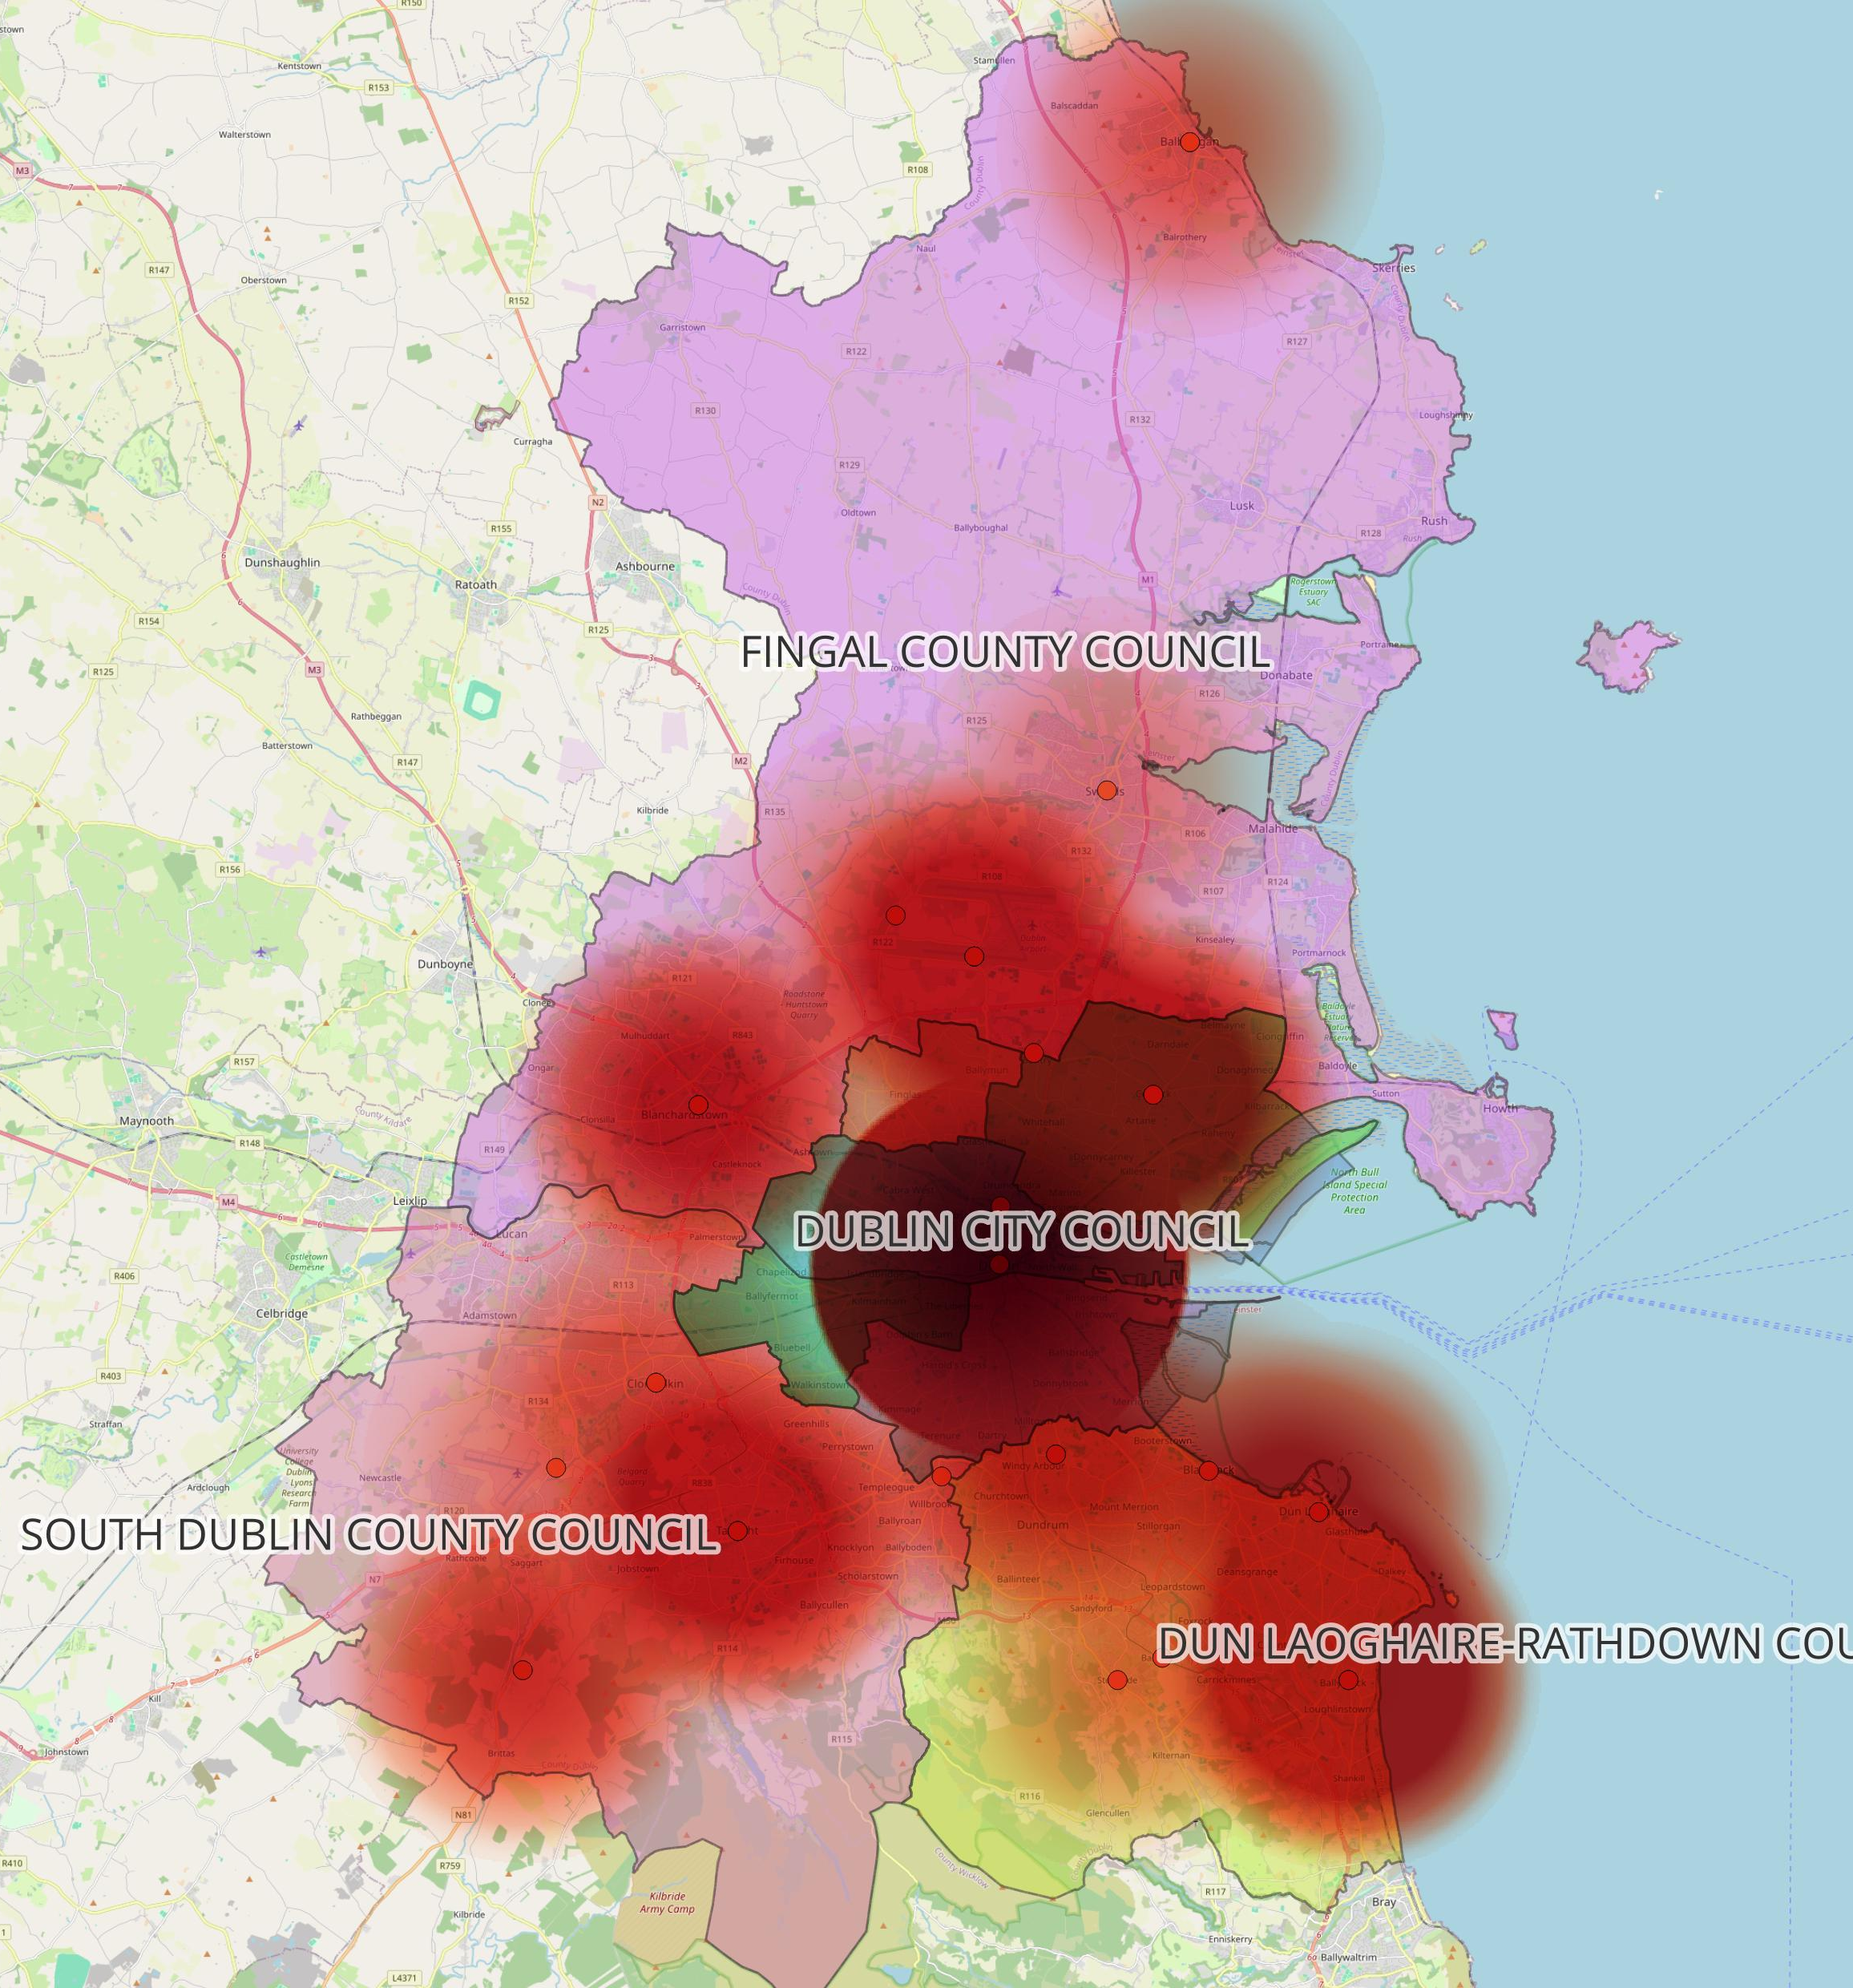
Heatmap of Crime Incidents
Highlights hotspots in central Dublin.
Created by clustering overlapping points using PostgreSQL and adding more weights to any crime that was not a peaceful protest using Attribute table in QGIS.
Insights:
Dense areas near Dublin city centre suggest urban activity and crowding.
Notes:
Using the crime coordinates, I generated a heatmap to highlight dense clusters of activity.
The heatmap revealed:
Central Dublin consistently emerges as a hotspot.
This reinforces the choropleth findings, with central areas experiencing the heaviest activity.

Slide 7
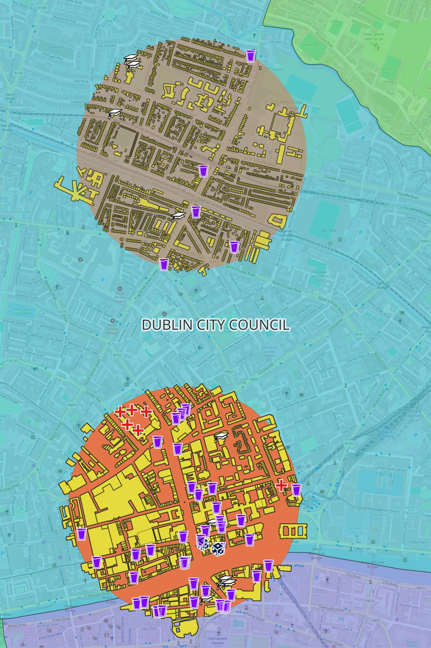
Buffer Analysis of Crime and Buildings
Map with 500m buffers around crime points, buildings overlaid with SVG markers.
Methodology:
Used ST_Buffer and ST_Intersects to analyze buildings near crimes.
Categorized buildings with distinct markers (e.g., + for hospitals, school icons).
Key Findings:
Proximity to pubs and casinos correlates with some hotspots.
Schools, colleges and universities are often within crime buffers.
Notes:
To delve deeper, I performed a buffer analysis, creating 500-meter zones around crime locations to analyze nearby buildings.
Key steps included:
Joining buildings and crime data in PostgreSQL using ST_Buffer and ST_Intersects.
Assigning unique symbols to buildings like hospitals, schools, pubs, and casinos for clear visualization.
Insights:
Many crime hotspots were within close proximity to pubs, bars, and casinos, suggesting a possible relationship with nightlife activity.
Schools and hospitals were also present in buffer zones, raising questions about safety near sensitive locations.

Slide 8
Spatial Queries and Insights
Examples of Queries:
Choropleth: SELECT region_name, COUNT(*) AS crime_count FROM dublin_crime GROUP BY region_name.
Heatmap: SELECT geom, COUNT(*) FROM dublin_crime GROUP BY geom.
Buffer Analysis: SELECT b.name, c.geom FROM buildings_dublin b JOIN dublin_crime c ON ST_DWithin(b.geom, c.geom, 500).
PostgreSQL Views:
Created views for each analysis in PostgreSQL and visualised it in QGIS.
Notes:
Here are some of the core PostgreSQL queries I used to generate insights:

Slide 9
Conclusion
This project demonstrated the power of spatial analysis to uncover patterns in crime distribution and its relationship with infrastructure.
Key Observations:
Dublin City Council has the highest crime density.
Heatmap and choropleth maps highlight urban core as the focal point for incidents.
Buffer analysis shows:
High proximity to pubs, bars, and casinos in crime-dense areas.
Schools, colleges and universities are often near crime spots, requiring preventive measures. Additionally, they could be contributing to the occurrence of crimes.
Spatial analysis suggests resource allocation should prioritize central Dublin.
Notes:
To summarize the findings:
Dublin City Council is the clear epicenter of crime, necessitating resource prioritization.
Heatmaps confirm clustering in central areas, aligning with urban density.
Buffer analysis points to a potential correlation between nightlife-related amenities and crime activity.
These insights could guide law enforcement and urban planners in targeting specific areas for intervention.

